Slide 1

CT4005: Games Production
Lecture 02 – Game Mechanics
John Moss, Dr Will Sayers, University of Gloucestershire

Slide 2

Sign in please
Password -

Slide 3
Overview
Unpredictability in games
Games Mechanics
Types of Mechanics
Mechanics as Metaphor
Frame Work

Slide 4

What is a mechanic…..?

Slide 5
Definition of a mechanic
Core Mechanics represent the essential moment-to-moment activity of players. During a game, core mechanics create patterns of repeated behaviour, the experiential building blocks of play.“ Katie Salen and Eric Zimmerman: Rules of Play
“Mechanics are the various actions, behaviours and control mechanisms afforded to the player within a game context. The mechanics support overall gameplay dynamics” Robin Hunicke, Marc LeBlanc and Robert Zubek: MDA Frame Work

Slide 6
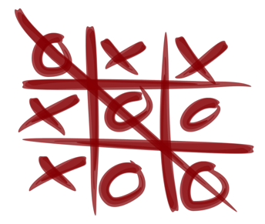
Mechanics
Tic-Tac-Toe
Objective
Get three of your X or O in a row to win
Mechanics
3x3 Table used
Players take turns
First player marks X / Second player marks O
Draw a line through to indicate the winner
Rules
Players can only put down 1 X/O at a time

Slide 7
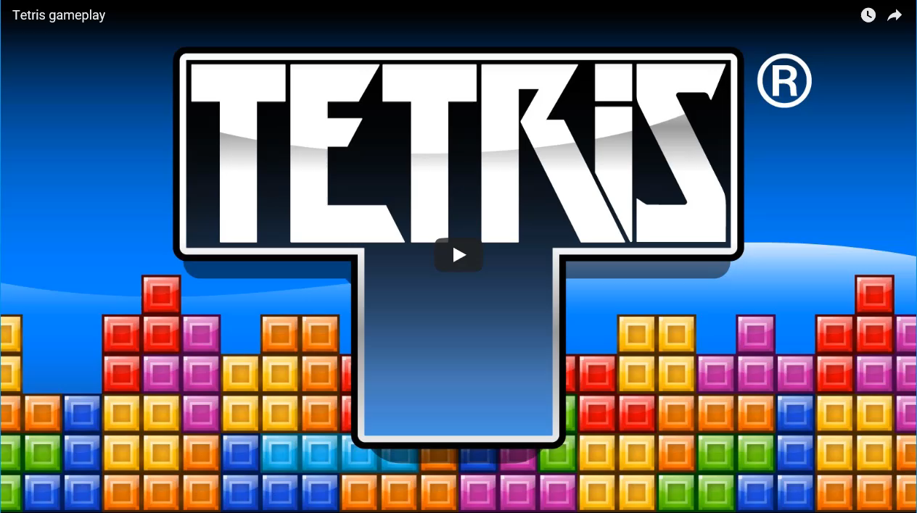
Lets look at a basic mechanic
Name the four mechanics on Tetris
Rotation system
Randomizers
Scoring Systems
Mobility

Slide 8

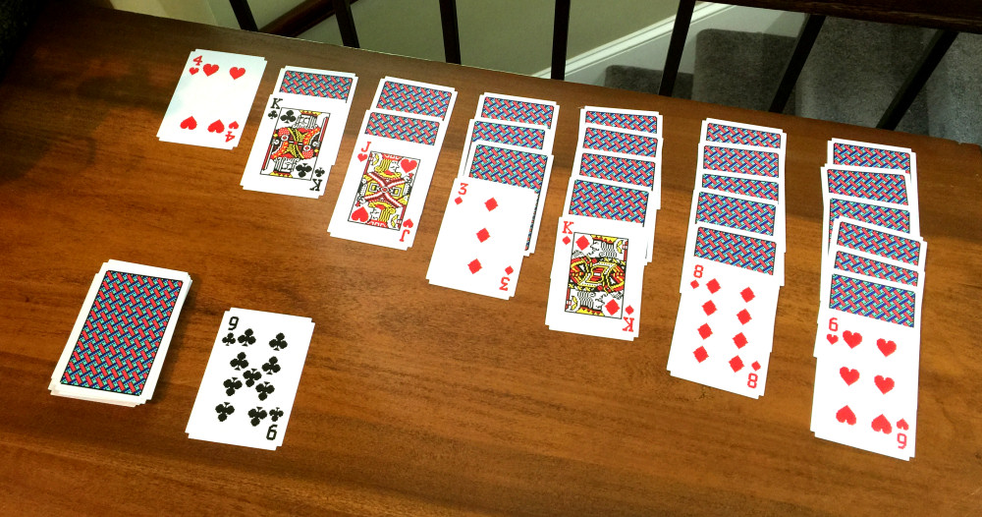
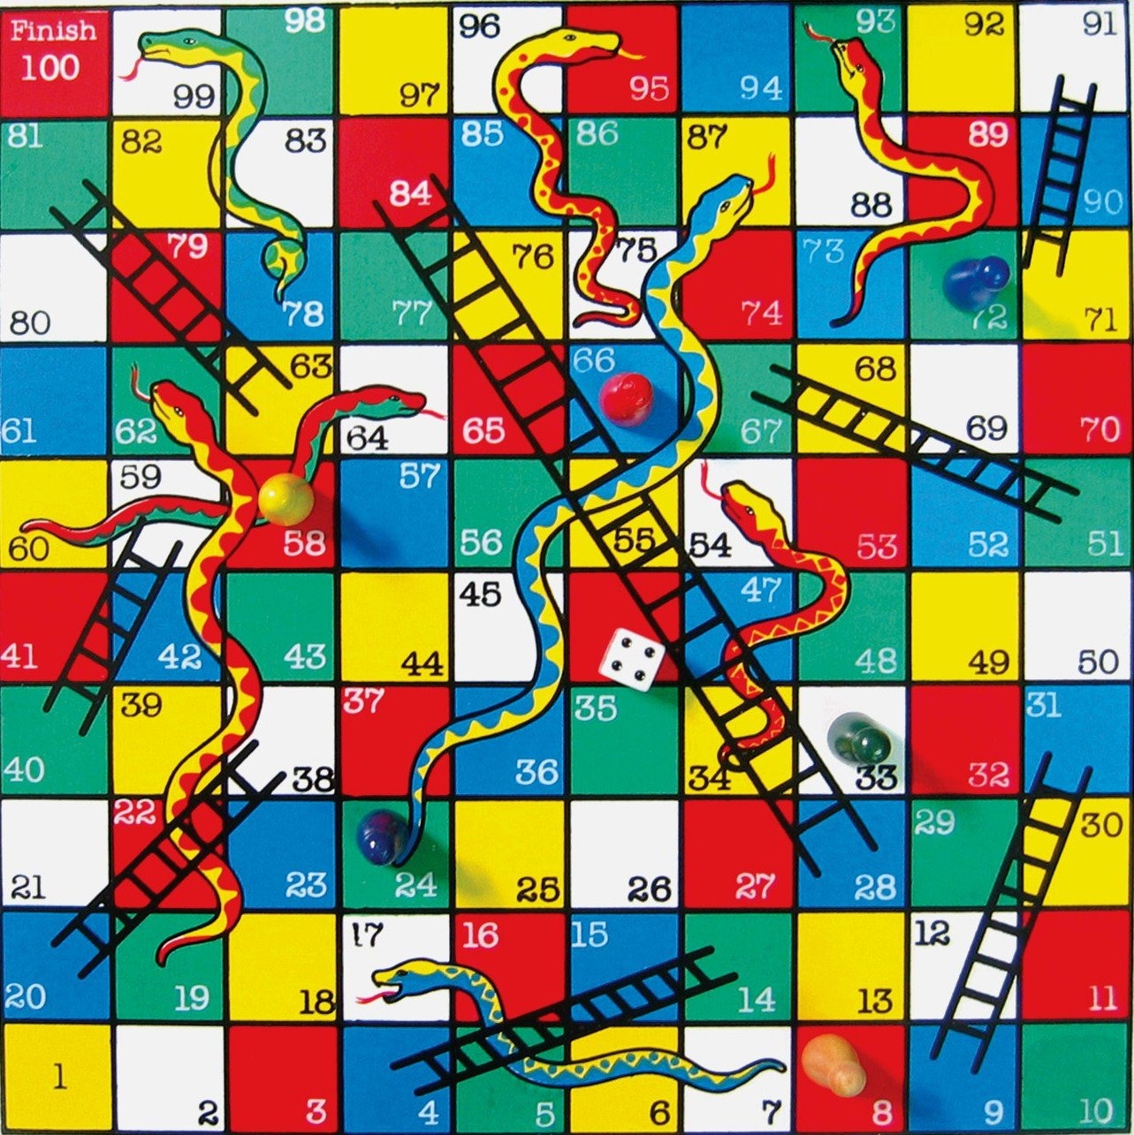
Games are Unpredictable
Game playing decisions and skills do not matter.
Frustration.
Boredom.
A games outcome should not be clear from the start:A game that is predictable is usually not much fun.
To a certain extent games should be unpredictable. Dice /Spinner
What’s bad about having a game that is unpredictable especially in longer games?
In addition to chance there are two other and more sophisticated ways to games unpredictable
Choices made by player
Gameplay created by the game rules
Fun fact
Chance or dice roles are called Stochastic processes
When an outcome can be determined this is called Deterministic processes
Notes:
Games Are Unpredictable
A game’s outcome should not be clear from the start: To a certain extent, games
should be unpredictable. A game that is predictable is usually not much fun. A simple
way of creating unpredictable outcomes is to include an element of chance, such as
a throw of the dice or the twirl of a spinner in a board game. Short games such as
blackjack or Klondike (the most familiar form of solitaire played with cards) depend
almost entirely on chance. In longer games, however, players want their skills and
their strategic decisions to make more of a difference. When players feel that their
decisions and game-playing skills do not matter, they quickly become frustrated.
Pure games of chance have their place in a casino, but for most other games, skill
should also contribute to victory. The longer the game is, the more true this is.
In addition to chance, there are two other, and more sophisticated, ways to make
games unpredictable: choices made by players and complex gameplay created by the
game’s rules.
Stochastic refers to a randomly determined process.^{[1]} The word first appeared in English to describe a mathematical object called a stochastic process, but now in mathematics the terms stochastic process and random process are considered interchangeable.^{[2][3][4][5][6]} The word, with its current definition meaning random, came from German, but it originally came from Greek στόχος (stókhos), meaning 'aim, guess'.^{[1]}

Slide 9
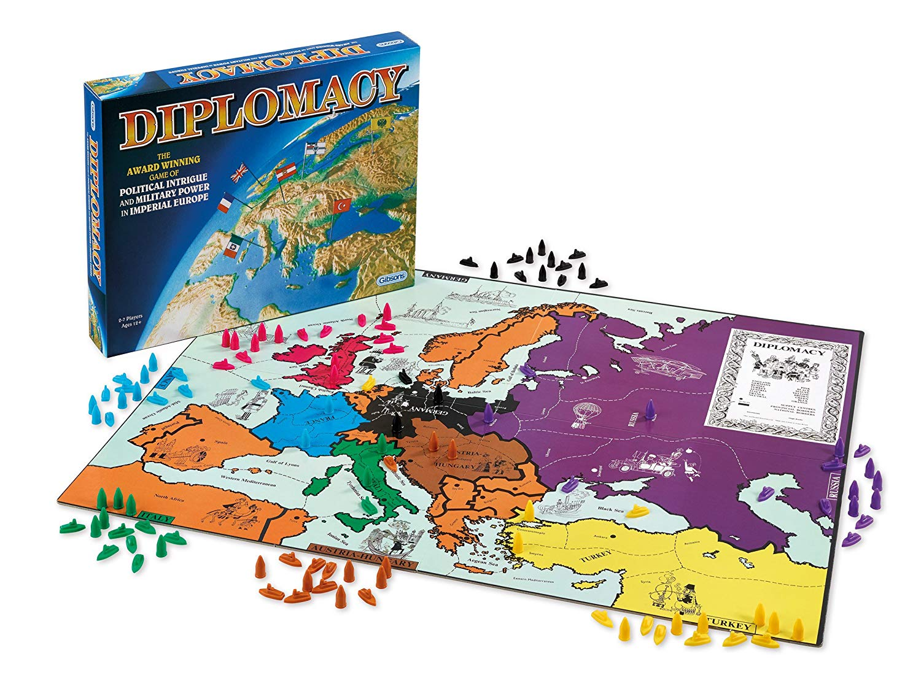
Games are Unpredictable
Supply centers 18/34
Rock paper scissors, is unpredictable as the outcome depends on the on the decision made by the players.
Second guessing
Empathy
Reverse psychology
Outside the individual player’s control
Diplomacy use a mixture of these as a mechanism
Use their social skills, negotiation, manipulation to find out where their opponent will strike.
Convince allies to support offensive and defensive maneuvers.
Notes:
A simple game such as rock-paper-scissors (or roshambo/rochambeau) is unpredictable
because its outcome depends on the decisions made by the players. The rules
do not favor one choice or another; they do not suggest a particular strategy. Trying
to second-guess or influence the choice of your opponent might involve empathy
or reverse psychology, but it remains largely outside the individual player’s control.
The classic board game Diplomacy uses a similar mechanism. In this game, players
control only a handful of armies and fleets. Victory in battle simply goes to the side
that committed the largest number of units to a battle. However, because all the
players write down their moves secretly and resolve their turns simultaneously, the
players must use their social skills to find out where their opponent will strike and
to convince their allies to support their offensive and defensive maneuvers.

Slide 10

Games are Unpredictable
When the rules of a game are complex, they can be unpredictable to us humans.
Behavior of individual parts easy to understand
Rules might be simple
However the behavior of all the parts combined can make it difficult to foresee and outcome.
The movement rules of the 16 chess pieces are simple but those simple rules produce a game of great complexity.
In this type of game the ability to read a games current state and understand it strategic complexity is the most important game- playing skill.
Most games mix these three sources of unpredictability. They include an element of chance, player choices, and complex rules.
Notes:
When the rules of a game are complex, they can also make a game unpredictable,
at least to human beings. Complex systems usually have many interacting parts.
The behavior of individual parts might be easy to understand; their rules might be
simple. However, the behavior of all the parts combined can be quite surprising and
difficult to foresee. The game of chess is a classic example of this effect. The movement
rules of the 16 chess pieces are simple, but those simple rules produce a game
of great complexity. Whole libraries have been written about chess strategies. Expert
players try to lure opponents into traps involving many pieces that might take multiple
turns to execute. In this type of game, the ability to read a game’s current state
and understand its strategic complexities is the most important game-playing skill.
Most games mix these three sources of unpredictability. They include an element of
chance, player choices, and complex rules. Different players prefer different combinations
of these techniques. Some like games that involve many random factors,
while others prefer games where complexity and strategy are key. Of these three
options, chance is the easiest to implement but not always the best source of unpredictability.
On the other hand, complex rule systems that offer many player choices
are difficult to design well. This book will help you with that task. We devote most
of the chapters to designing rule systems that create, among other things, interesting
choices for players. In Chapter 6, “Common Mechanisms,” we cover random
number generators (the software equivalent of dice) and discuss them at several other
points as well, but we feel that chance serves a supporting, rather than a central,
role in mechanics design.

Slide 11
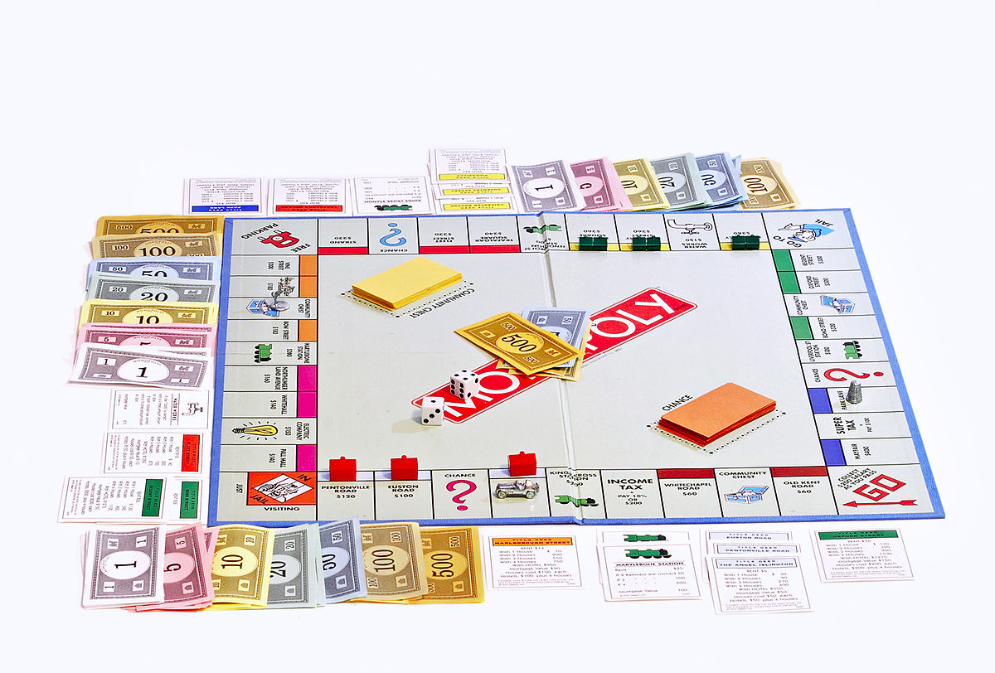
Mechanics are concreate
Mechanics are hidden from player implanted in the software.
What's the different between rules of a board games and rules in a video game?
Video games teach and introduce us as we play.
Rule and mechanics are related concepts but mechanics have to be more detailed and concreate.
Mechanics - prices of all the properties and the text of all the Chance and Community Chest cards—in other words, everything that affects the operation of the game.
Mechanics specify all the required details.
Notes:
From Rules to Mechanics
The video game design community usually prefers the term game mechanics to game
rules because rules are considered printed instructions that the player is aware of, while
the mechanics of video games are hidden from the player, that is, implemented in
software for which the player is given no direct user interface. Video game players
don’t have to know what the game’s rules are when they begin; unlike board and card
games, the video game teaches them as they play. Rules and mechanics are related
concepts, but mechanics are more detailed and concrete. For example, the rules of
Monopoly consist of only a few pages, but the mechanics of Monopoly include the
prices of all the properties and the text of all the Chance and Community Chest
cards—in other words, everything that affects the operation of the game. Mechanics
need to be detailed enough for game programmers to turn them into code without
confusion; mechanics specify all the required details.

Slide 12
Five different types of Mechanics
The term mechanics has come to indicate many different types of underlying relationships between entities in games. Here are five different types of mechanics that you might expect to find in a game:

Slide 13
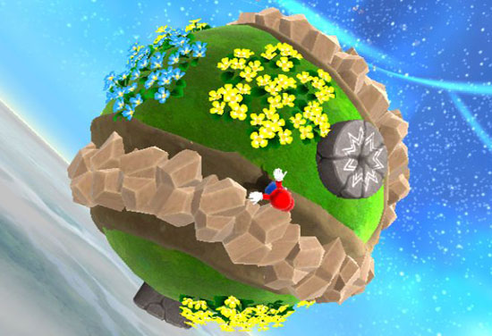
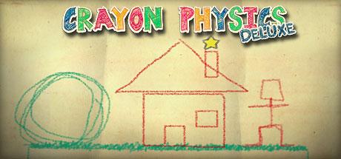
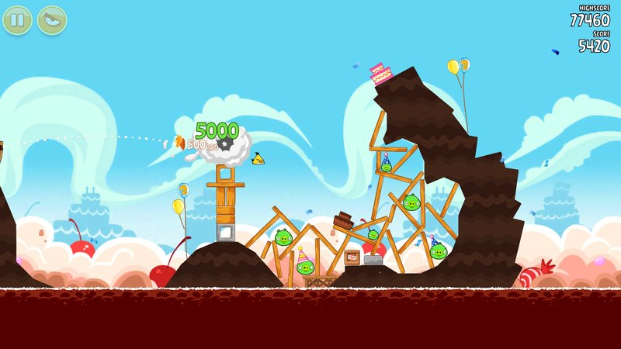
Physics Science of motion and force (timing and rhythm challenges can be considered to be part of a game’s physics)
Notes:
Physics. Game mechanics sometimes define physics—the science of motion and
force—in the game world (which can be different from the physics of the real world).
In games, characters commonly move from place to place, jump up and down, or
drive vehicles. Computing a game element’s position, the direction in which it is
moving, and whether it intersects or collides with other elements makes up the bulk
of the calculations in many games. Physics plays a large role in many modern games,
from ultrarealistic first-person shooters to the popular physics-puzzle games such
as Angry Birds. The implementation is seldom strict; however, games with so-called
cartoon physics use a modified version of Newtonian mechanics so that characters
can do non-Newtonian things such as change direction while in midair. (We also
consider such things as timing and rhythm challenges to be part of a game’s physics.)

Slide 14
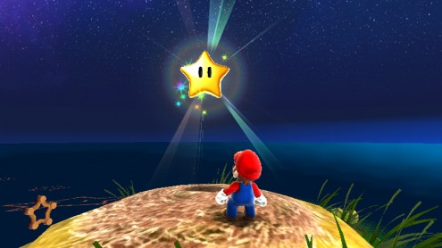
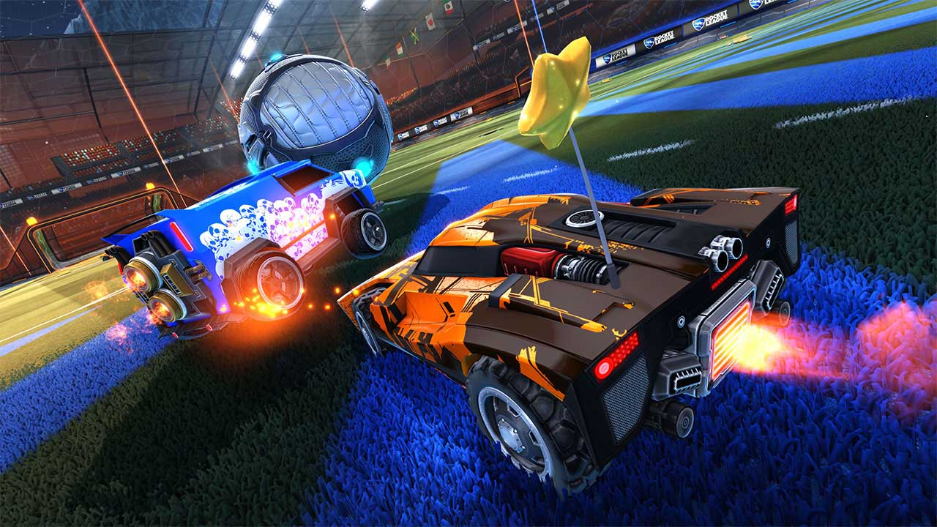
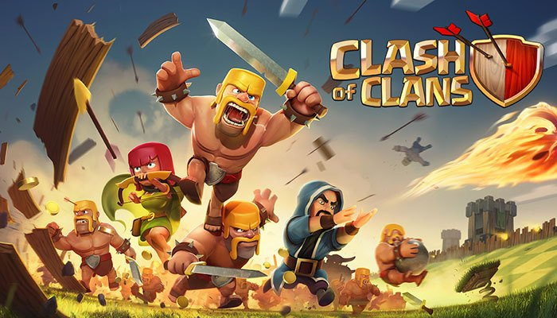
Internal economy (the mechanics of transactions involving game elements, collected, consumed and traded) resources: money, energy, ammunition, and so on. Can involve abstractions (health, popularity, and magical powers)
Notes:
https://www.gamasutra.com/view/feature/130188/gameplay_design_fundamentals_.php?print=1
Internal economy. The mechanics of transactions involving game elements
that are collected, consumed, and traded constitute a game’s internal economy.
The internal economy of a game typically encompasses items easily identified as
resources: money, energy, ammunition, and so on. However, a game’s economy
is not limited to concrete, tangible items; it can also include abstractions such as
health, popularity, and magical power. In any Zelda game, Link’s hearts—a visible
measure of his life energy—are part of the internal economy. Skill points and other
quantified abilities in many role-playing games also qualify; these games have very
complex internal economies.

Slide 15
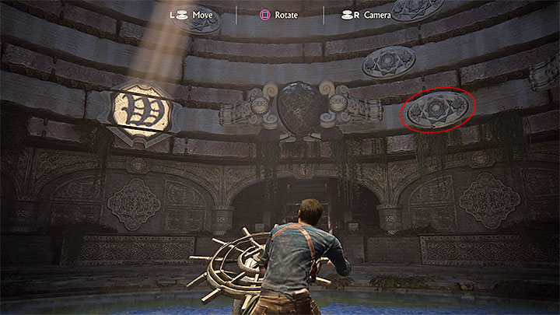
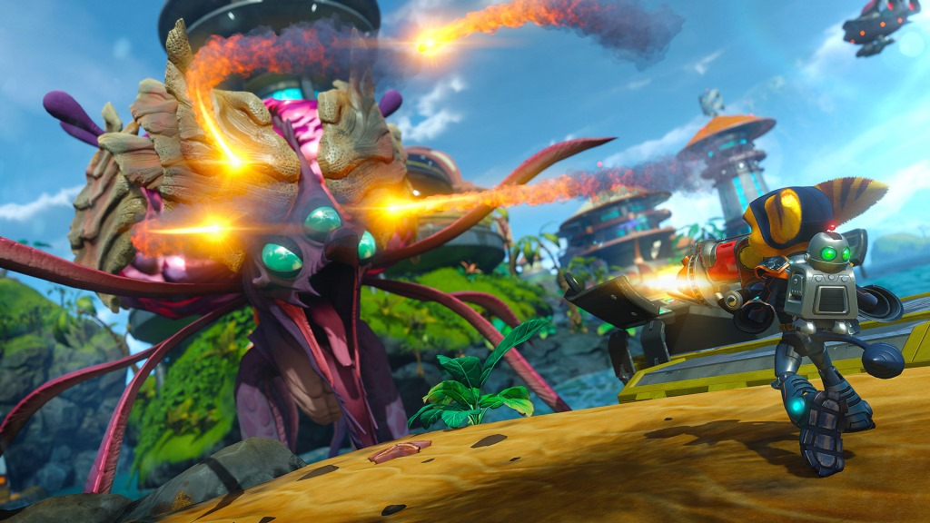
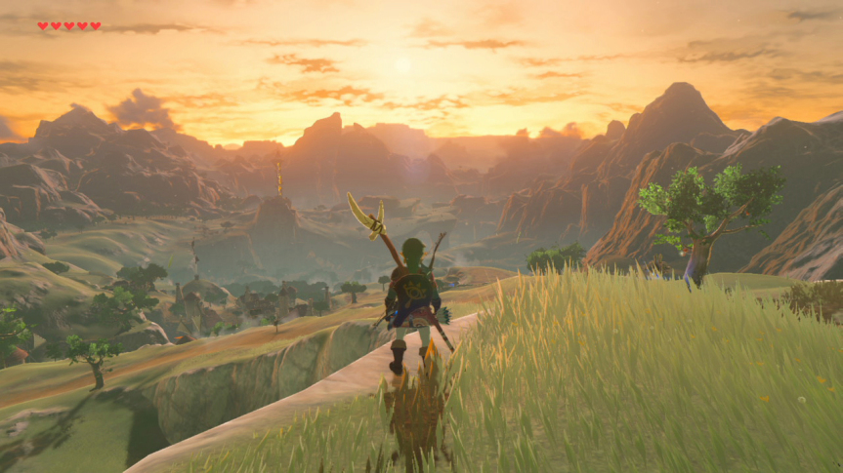
Progression (level design decide how you can move through a game world) progress of the player is tightly controlled by a number of mechanisms that block or unlock access to certain areas. Levers, switches, and magical swords that allow you to destroy certain doors are typical examples of such progression mechanisms.
Notes:
Progression mechanisms. In many games, level design dictates how a player can
move through the game world. Traditionally, the player’s avatar needs to get to a
particular place to rescue someone or to defeat the main evil-doer and complete the
level. In this type of game, the progress of the player is tightly controlled by a number
of mechanisms that block or unlock access to certain areas. Levers, switches, and
magical swords that allow you to destroy certain doors are typical examples of such
progression mechanisms.

Slide 16
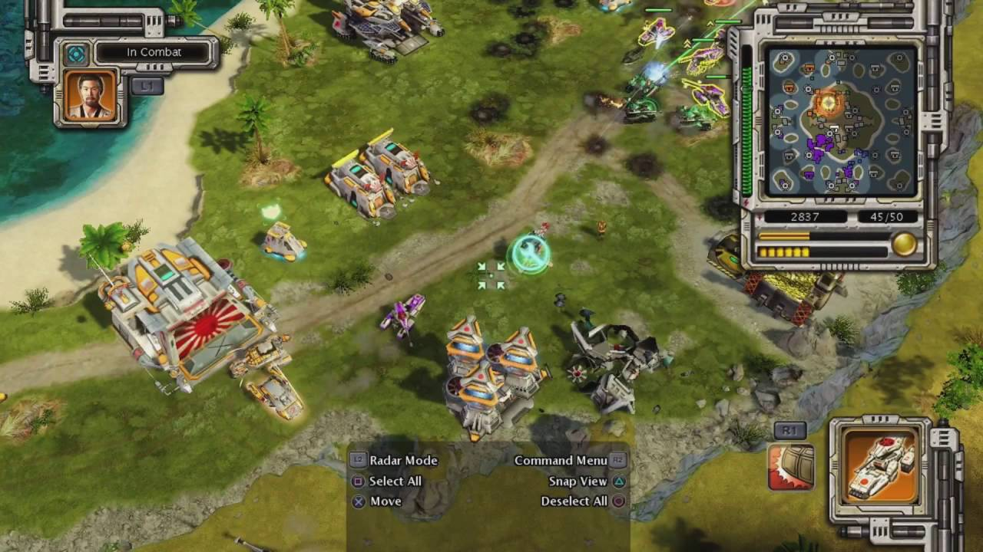
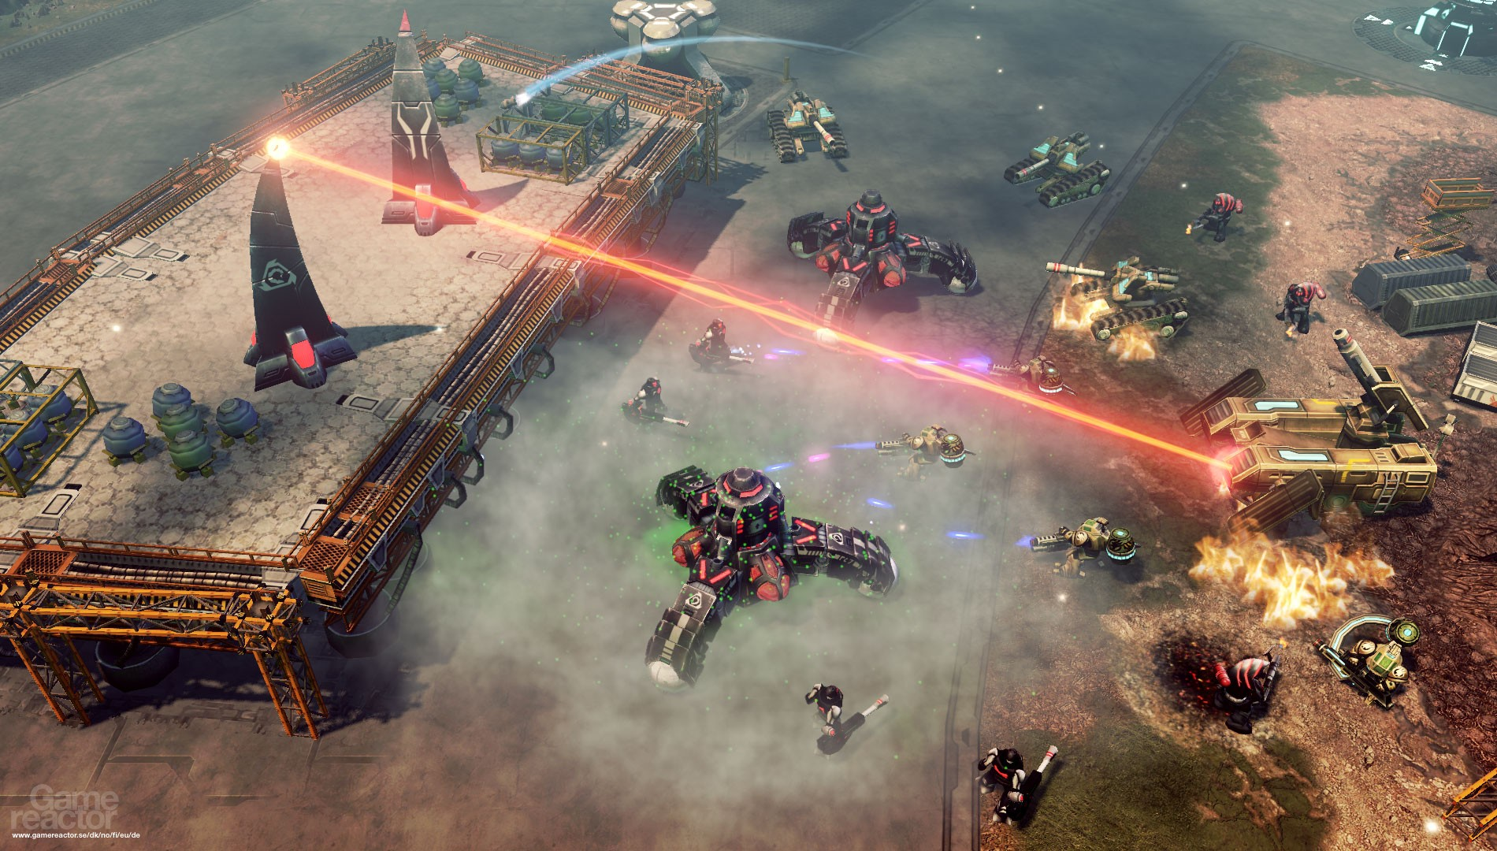
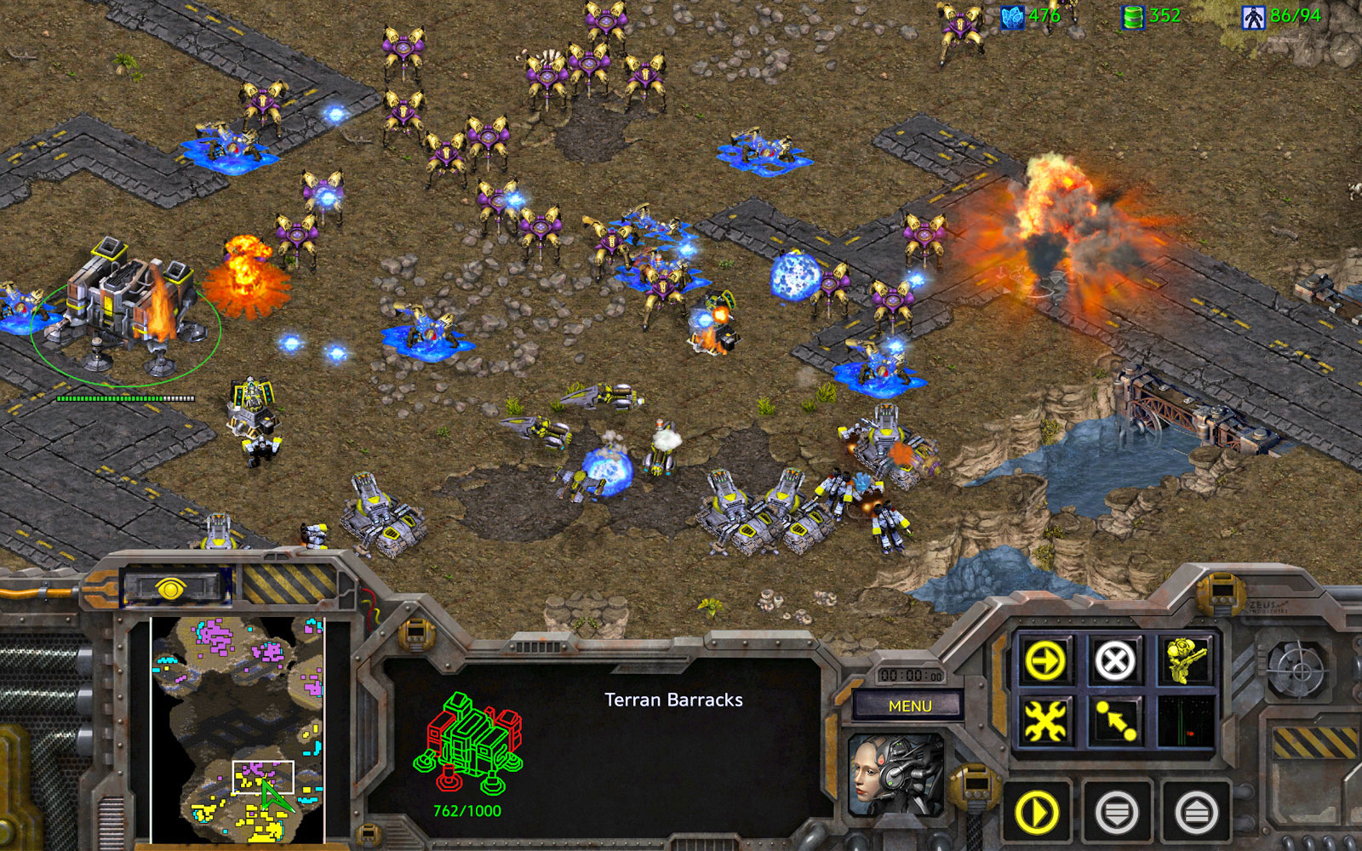
Tactical manoeuvring Tactical maneuvering is critical in most strategy games but also features in some role-playing and simulation games. appears in many board games such as chess and Go but also in computer strategy games such as StarCraft or Command & Conquer: Red Alert.
Notes:
Tactical maneuvering. Games can have mechanics that deal with the placement
of game units on a map for offensive or defensive advantages. Tactical maneuvering
is critical in most strategy games but also features in some role-playing and simulation
games. The mechanics that govern tactical maneuvering typically specify what
strategic advantages each type of unit may gain from being in each possible location.
Many games restrict the location of units to discrete tiles, as is the case for a classic
board game like chess. Even modern strategy games played on the computer often
implement tiles, although they do a good job of hiding them behind a detailed
visual layer. Tactical maneuvering appears in many board games such as chess and
Go but also in computer strategy games such as StarCraft or Command & Conquer:
Red Alert.

Slide 17
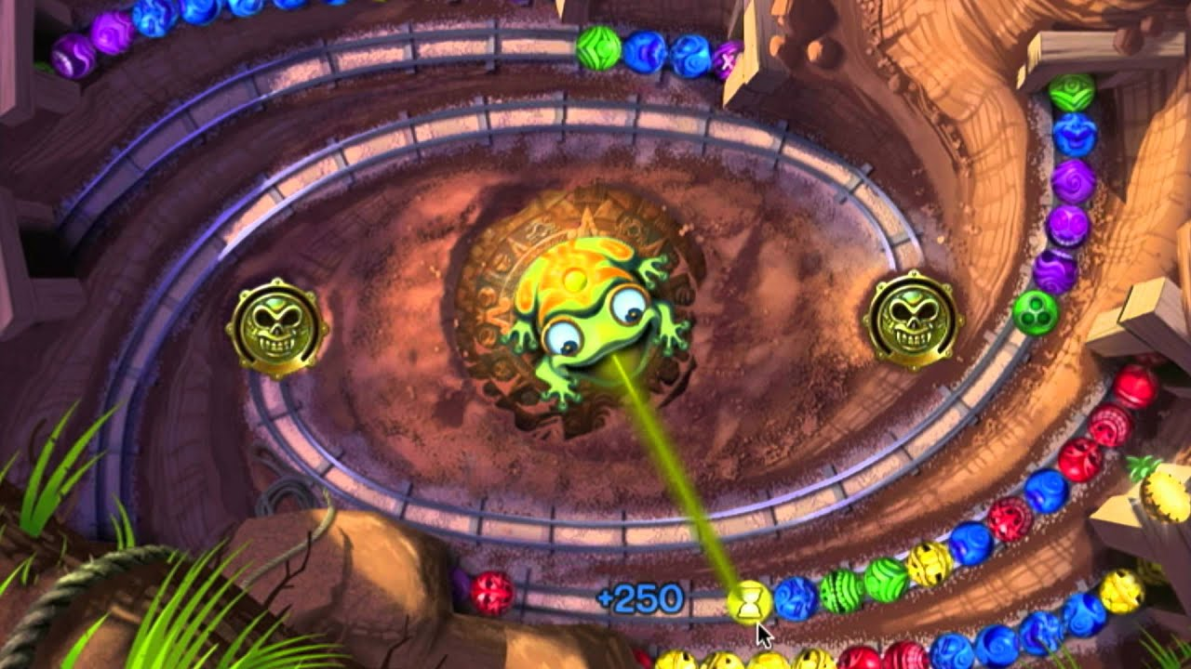
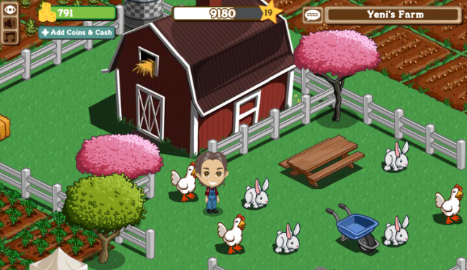
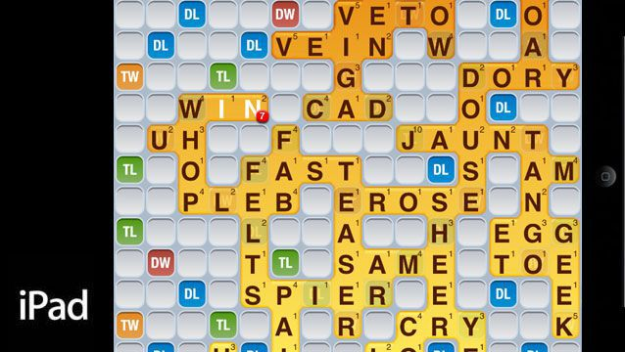
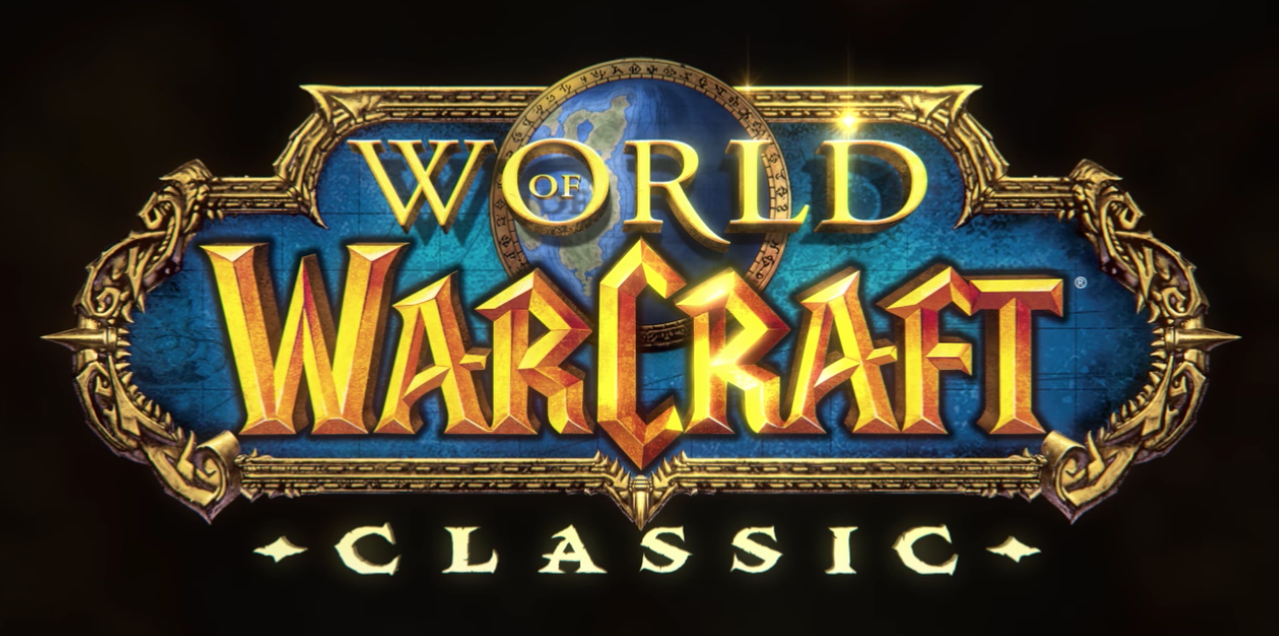
Social interaction Zynga's farm simulation game is the neighbour system Zuma - rankings are constantly updated with your friends' high scores. Words with friends - It's just Scrabble! WOW -Instead of just fighting monsters or levelling up a character by yourself, you get to do it with thousands of other players and interact with them in many different ways ranging from personal e-mails to public online chats.
Notes:
https://mashable.com/2011/02/15/top-social-games/?europe=true#iZv7XlTwWkqZ
The Social Gaming Development Series is supported by Level 3 Communications, an international provider of fiber-based communications services. Level 3 is committed to carrying digital media from anywhere to anywhere, in whatever format needed.
Around 68.7 million Americans will be playing social games by 2012, according to analysis firm eMarketer. A number like that might seem unreal, but it makes perfect sense. There's something extraordinarily appealing about logging into Facebook or picking up your smartphone and instantly playing a game alongside countless other people across the world.
But why do the best social games work so well? How do they manage to connect us in ways we wouldn't have thought possible just ten years ago? Let's look at five of the most popular social games and try to figure out why they're hits.
1. FarmVille
FarmVille is doing a lot of things right, really — that's why close to 10% of all Facebook users play FarmVille. But one of the most ingenious mechanics in Zynga's farm simulation game is the neighbour system. It's easy enough to harvest crops and build up your farm alone, but when you do it with your Facebook friends, your productivity skyrockets exponentially. And if you've ever hopped onto your news feed only to be subjected to a deluge of FarmVille updates, you know just how tempting it can be to click around and see what the fuss is all about.
Either this is a metaphor for real farms, where workers have to cooperate to stay alive, or it's just a ploy to get people to recruit one another so Zynga can harvest all of your money. The gaming company has used the social promotion lessons it learned from FarmVille to launch CityVille last year, which has already become the most popular game on Facebook with almost 100 million users (twice that of FarmVille).
2. Zuma Blitz
PopCap's addictive ball matching game is fun to play in both short and long doses, but its real strength lies in its scoreboard. As you go about your business in Zuma's Incan temple, you'll see a set of rankings on the right side of your screen. Those rankings are constantly updated with your friends' high scores, allowing you to talk smack as you compete with one another for slot number one. It's a brilliant, simple, and effective technique that keeps players hooked for one simple reason: Bragging rights.
3. Words With Friends
Imagine if Scrabble was available on your phone 24/7. Now imagine that instead of playing against a computerized opponent, you could compete with any of your friends whenever you wanted, picking when to play each word at your own personal discretion. That's Words With Friends.
Scrabble has always been immensely popular, so it's easy to see why online Scrabble is just as lauded. Words With Friends works because it successfully emulates a classic game that everybody already understands — no need to worry about learning complicated new rules or devising intricate strategies. It's just Scrabble!
4. Mafia Wars
Between The Godfather, The Sopranos, Goodfellas, and the countless other mob stories that have been both critically and commercially acclaimed over the years, it's not hard to see why a game like Mafia Wars works. Though this Facebook mob simulator — which lets you recruit friends and form your own criminal organization — can't be fairly compared to any of those classic pieces of pop culture, it's certainly an impressive game that you can sink way too much time into. Teaming up with your buddies in order to fight mobsters, perform "jobs," and pretend to be criminals is way more fun than it should be.
5. World of Warcraft
Sure, when you think World of Warcraft, you might picture the nerdier set — those who may have sacrificed hygiene and sleep to reach one more experience level. But the truth is that WoW is populated with players of all sorts of backgrounds, from rural housewives to NFL punters. The game currently boasts over 12 million subscribers, mostly because of its social capabilities. Instead of just fighting monsters or leveling up a character by yourself, you get to do it with thousands of other players and interact with them in many different ways ranging from personal e-mails to public online chats.
Most strikingly, World of Warcraft allows you to live a veritable second life. Girls can pretend to be boys; boys can pretend to be girls; human accountants can pretend to be elven mages. You can make friends and enemies, form relationships and even take on an entirely new persona. For better or worse, some people enjoy socializing on WoW more than real life, which may make it the most powerful social game out there. Oh, and Mila Kunis plays it, which might be a good reason to start.

Slide 18
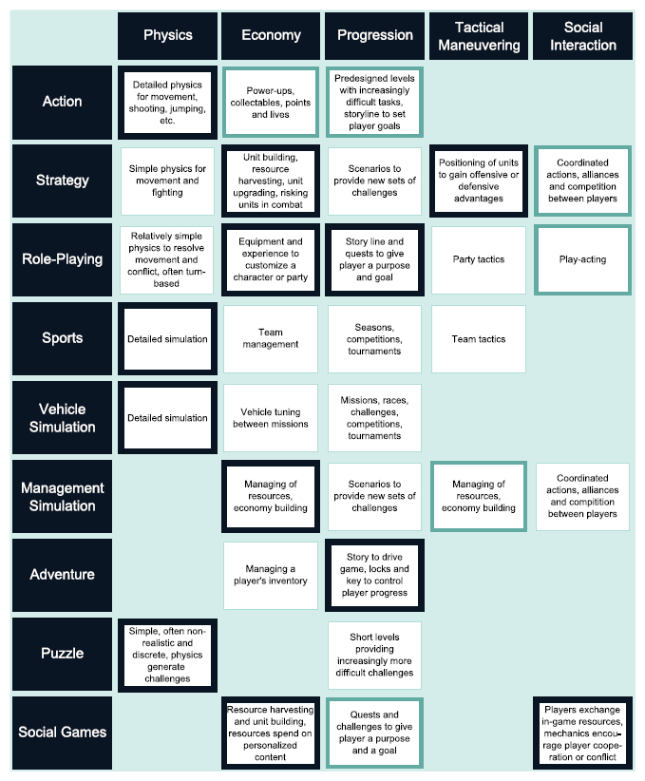
Mechanics and game genres
The game genres in the table are taken from Fundamentals of Game Design, Second Edition and correlate to the five different types of game rules or structures.
Table 1.1 shows a typical game classification scheme and how these genres and their associated gameplay relate to different types of mechanics.
The thickness of the outlines indicates relative importance of those types of rules for most games in that genre.
Notes:
Mechanics and Game Genres
The game industry categorizes games into genres based on the type of gameplay the
game offers. Some games derive their gameplay mostly from their economy, others
from physics, level progression, tactical maneuvering, or social dynamics. Because
the gameplay is generated by the mechanics, it follows that the genre of a game
has a significant effect on the kinds of rules it implements. Table 1.1 shows a typical
game classification scheme and how these genres and their associated gameplay
relate to different types of mechanics. The game genres in the table are taken from
Fundamentals of Game Design, Second Edition and correlate to the five different types
of game rules or structures. The thickness of the outlines indicates relative importance
of those types of rules for most games in that genre.

Slide 19
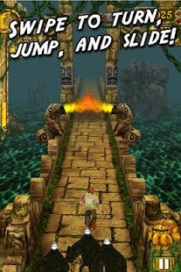
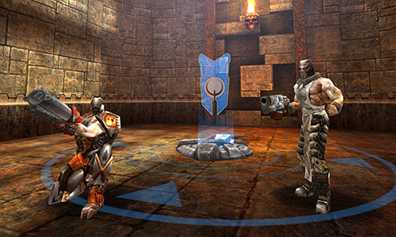
Core Game mechanics
Every game has a core mechanic.
Experiential building blocks of player interactivity
Repeated over and over throughout a game
create patterns of behaviour, which manifest as experience for players
Meaningful choices and arrive at a meaningful play experience
Notes:
A game's core mechanic contains the experiential building blocks of player interactivity. It represents the essential mom-ent-to-moment activity of players, something that is repeated over and over throughout a game. During a game, core mechanics create patterns of behaviour, which manifest as experience for players. The core mechanic is the essential nugget of game activity, the mechanism through which players make meaningful choices and arrive at a meaningful play experience.

Slide 20


Core Game mechanics CONTEXT
Designing the activity of play means creating the system that includes the game's sensory output to the player and the play-er's ability to make input, as well as guiding the internal cognitive and psychological processes by which a player makes decisions……
what the????
The repetition of the core mechanic enacted over the course of a game builds into larger patterns of experience as players run about the field, avoiding the player that is "It," exchanging roles of the hunter and the hunted when a tag takes place. As an experienced game system, Tag's mythic simplicity is part of its appeal.
In Verbal Tennis, the actual activity of the player is merely to listen and to speak, something that players do in their ordinary lives many times a day. The elegance of the game is that a simple set of rules transform this action into the puzzle-like experience of Verbal Tennis, resulting in an intellectually challenging and theatrically engaging game experience.
Notes:
A game's core mechanic contains the experiential building blocks of player interactivity. It represents the essential mom-ent-to-moment activity of players, something that is repeated over and over throughout a game. During a game, core mechanics create patterns of behaviour, which manifest as experience for players. The core mechanic is the essential nugget of game activity, the mechanism through which players make meaningful choices and arrive at a meaningful play experience.

Slide 21
Gated access or direct gameplay
The 2 main styles of mechanics progression that can be used in games with even a moderate level of mechanics complexity are what I call Gated Access and Directed Gameplay:
Gated Access – make some mechanics unavailable initially until a later point in the game (via inventory, disabled controls that later get enabled, or progressively adding in new moves, etc.).
Directed Gameplay – make all mechanics available up front but direct the gameplay (missions or levels) to utilize mechanics progressively (so the first levels only require the basics and each level or stage layers on something new).

Slide 22
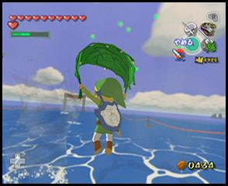
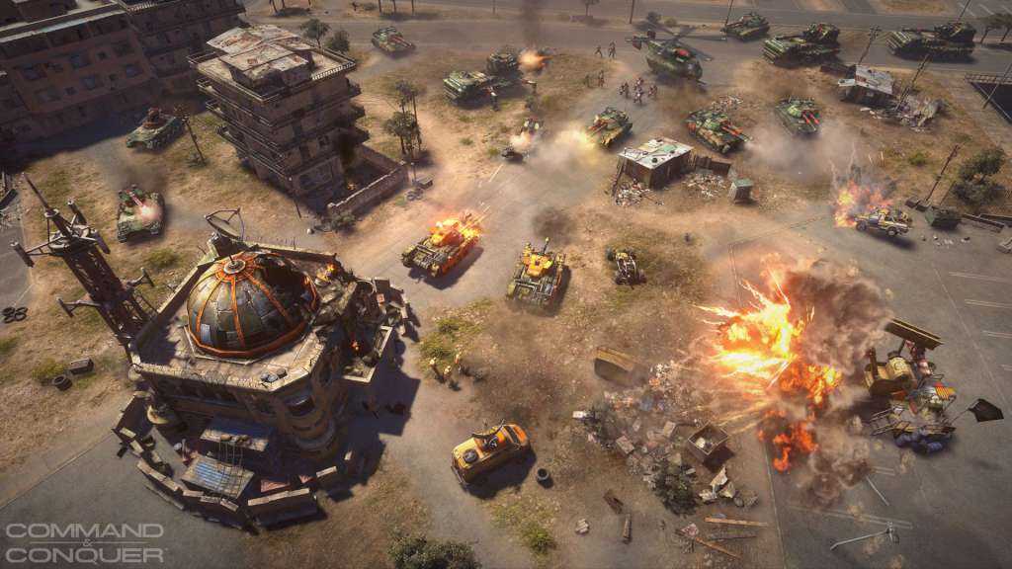
Gated access or direct gameplay
Ratchet & Clank or adventure games like Zelda have entirely separate levels dedicated to new mechanics and these top-quality games take a lot of care to reveal these mechanics progressively, and they feature them even more by making all content on those levels support the new mechanics.
Most great RTS games (Command & Conquer, etc.) control the progression during the single player campaign by initially limiting the tech level drastically at the beginning so that you learn the basics before more buildings and units are revealed at later levels.
(for example this leaf-wielding flight and fan level in Zelda: The Wind Waker).
Notes:
Platform games like Ratchet & Clank or adventure games like Zelda have entirely separate levels dedicated to new mechanics and these top-quality games take a lot of care to reveal these mechanics progressively, and they feature them even more by making all content on those levels support the new mechanics (for example this leaf-wielding flight and fan level in Zelda: The Wind Waker).
Most great RTS games (Command & Conquer, etc.) control the progression during the single player campaign by initially limiting the tech level drastically at the beginning so that you learn the basics before more buildings and units are revealed at later levels. Many great action games also reveal new attack moves, or abilities as the game progresses.

Slide 23
Mechanical Game Structure
Game mechanics define how the player interacts with basic / complex elements in the game world
Split up into three sections
Tokens
Any object in the game that can be or is manipulated
A players avatar or an enemy
Verbs | Rules
Discreet actions that can be performed by tokens on other tokens | The basic rules of interaction between tokens and verbs
Jumping or Running in a platform game | The logic that an avatar jumping on an enemy kills it

Slide 24
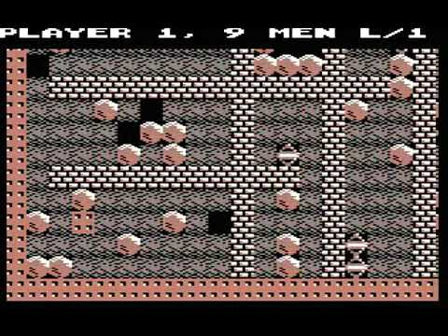
Understanding the Mechanics of Physics
Modern games tend to simulate physics (including timing and rhythm) with precise mechanics that create a smooth, continuous flow of play. A game object might be positioned half a pixel more to the left or right, and this can have a huge effect on the result of a jump. For maximum accuracy, physical behaviours need to be computed with high-precision fractional values; this is what we mean by continuous mechanics.
In contrast, the rules of an internal economy tend to be discrete and represented with integer (whole-number) values. In an internal economy, game elements and actions often belong to a finite set that does not allow any gradual transitions: In a game you usually cannot pick up half a power-up. These are discrete mechanics.
In Boulder Dash, gravity is simulated by moving boulders down at a constant speed of one tile every frame.
Notes:
https://www.slideshare.net/pierluca.lanzi/game-mechanics-55644725
There are different types of variables that are used in different situations: strings, integers, and arrays. There are different types of variables that are used in different situations: strings, integers, and arrays. We’re going to talk about integers, which are whole numbers that can be positive, negative, or zero.
Understanding the Mechanics of Physics
Accurate physics computations, especially in real time, require a lot of high-speed
mathematical operations. This tends to mean that physics-based games must be
implemented on a computer. Creating a board game for Super Mario Bros., in which
the gameplay requires moving and jumping from platform to platform, would be
difficult. In platform games, physical dexterity matters, just as it does in playing
real-life football; those skills would be lost in a board game. Super Mario Bros. is probably
better mediated as a physical course testing players’ real running and jumping
abilities. The point is, a rule that states that you can jump twice as high after picking
up a certain item can be easily translated between different media, but actually
implementing that jump cannot. The continuous, physical mechanics of a game
need computing power more than the discrete rules that govern a game’s economy.
Interestingly, when you look back at the early history of platform games and other
early arcade games, the physics calculations were more discrete than they are today.
The moves in Donkey Kong were much less continuous than they were in Super Mario
Bros. In Boulder Dash, gravity is simulated by moving boulders down at a constant
speed of one tile every frame. It might play slowly, but it is possible to create a board
game for Boulder Dash. In those days, the rules that created the game’s physical
mechanics were not that different from other types of game rules. The early game
computers did not have any floating-point arithmetic instructions, so the game
physics had to be simple. But times have changed. Today the physics in a platform
game have grown so accurate and detailed that they have become impossible, or at
least inconvenient, to represent with a board game.

Slide 25
discrete
Angry Birds and World of Goo, two games that mix physical mechanics with strategic gameplay.
CONTINUOUS
Detailed physical simulation that controls the player-built constructions.
spring forces push the ball into the same place. (Shows connections on fig)
Uses discrete mechanics and is more strategic in game play.
High-precision fractional values, continuous, pixel-precise physics.
In Angry Birds, the difference of a single pixel can translate into a critical hit or complete miss.
Uses continuous mechanics and based on hand eye coordination.
Notes:
Mixing Physical Mechanics with Strategic Gameplay
With discrete rules, it is possible to look ahead, to plan moves, and to create and
execute complex strategies. Although this isn’t always easy, it is possible, and many
players enjoy doing it. Players interact with discrete mechanics on a mental, strategic
level. Once players grasp the physics of a game, they can intuitively predict
movements and results, but with less certainty. Skill and dexterity become a more
important aspect of the interaction. This difference is crucial for gameplay and can
be seen in a comparison between Angry Birds and World of Goo, two games that mix
physical mechanics with strategic gameplay.
In Angry Birds, players shoot birds from a catapult at defensive structures protecting
pigs (Figure 1.2). The catapult is operated with a touch device, and because the
physical simulation is so precise, a small difference in launch speed or angle can have
a completely different effect on the structural damage the player causes. Catapulting
the birds is mostly a matter of physical skill. The strategy in Angry Birds involves
those aspects of the game that are governed by discrete rules. Players have to plan
to attack the pigs’ defenses most effectively using the number and types of birds
available in the level. This requires identifying weak spots and formulating a plan
of attack, but the execution itself is based on hand-eye coordination, and the effects
can never be foreseen in great detail.
Compare the mix of strategy and skill in Angry Birds with a similar mix in World of
Goo (Figure 1.3). In World of Goo, players build constructions from a limited supply
of goo balls. The game includes a detailed physical simulation that controls the
player-built constructions. Physical phenomena such as gravity, momentum, and
center of mass play an important role in the mechanics of the game. Indeed, players
can form an intuitive understanding of these notions from playing World of Goo. But
more importantly, players learn how to manage their most important (and discrete)
resource, goo balls, and use them to build successful constructions. The difference
between Angry Birds and World of Goo becomes very clear when you consider the
respective effects of both games’ continuous, pixel-precise physics. In Angry Birds,
the difference of a single pixel can translate into a critical hit or complete miss.
World of Goo is more forgiving. In that game, releasing a goo ball a little more to the
left or right usually does not matter, because the resulting construction is the same,
and spring forces push the ball into the same place. The game even shows what
connections will be made before the player releases a ball (as shown in Figure 1.3).
You can see that the gameplay is more strategic in World of Goo than it is in Angry
Birds. World of Goo depends more on its discrete mechanics than on its continuous
mechanics to create the player’s experience.

Slide 26
Can Mechanics have metaphor? Part01
Play this for five mins please
(with sound if you can, preferably headphones)
Notes:
https://www.necessarygames.com/my-games/loneliness/flash

Slide 27


Can Mechanics have metaphor? Part02
How did that make you feel?
The mechanics can bring narrative
It has a different meaning for different people
Did some of you avoid the pixels; try and go towards the pixels; Couldn’t be bothered?
At the end of the day this reinforces that this has meaning as you explored. This is clever and very trusting as makes the assumption you the audience have imagination.
How many of you personified the pixels as people.
Watch these short clips for more info

Slide 28
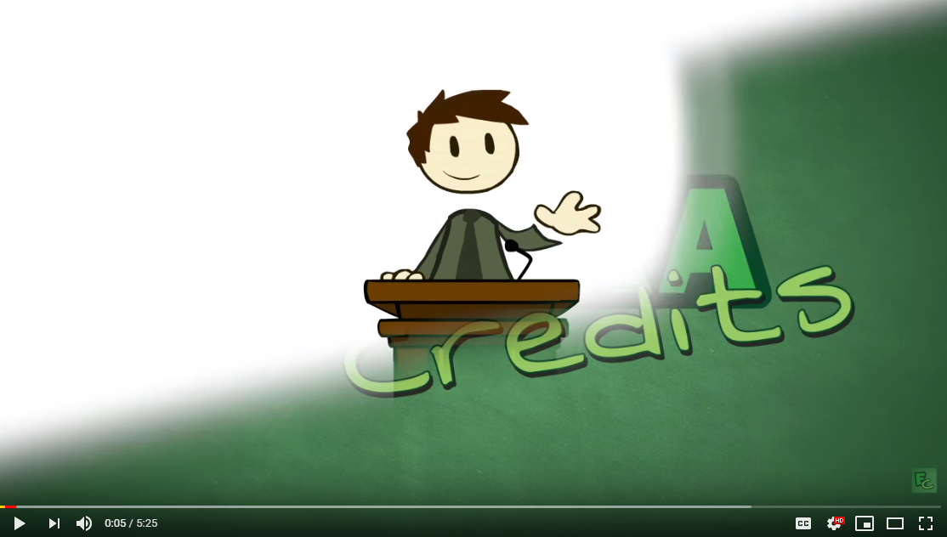
Mechanic can set the tone.

Slide 29
MDA / 6-11 fRAMEWORK
Frame works for Analysis

Slide 30
Games as software
Code
Process
Requirements
Rules
Game
“Session”
“Fun”

Slide 31
Games as software
Code
Mechanics
Process
Requirements
Rules
Game
“Session”
“Fun”

Slide 32
Games as software
Mechanics
Process
Dynamics
Requirements
Game
“Fun”

Slide 33
Games as software
Mechanics
Dynamics
Aesthetics
M D A

Slide 34
Mda frame work
Game mechanics are the core of what a game truly is. They are the interactions and relationships that remain when all of the aesthetics, technology, and story are stripped away.
Robin Hunicke, Marc LeBlanc and Robert Zubek defined MDA in 2001
[PDF link]
The MDA framework was first proposed in 2004, and attempts to connect the developers with the analytical gamers using three simple categories: Mechanics, Dynamics, and Aesthetics.

Slide 35
Mechanics - frame works / Theories
Stands for mechanics, dynamics and aesthetics, the three layers that define a game. These words are often thrown around casually in game design discussions, but in MDA they have very specific meanings:
Mechanics are the base components of the game - its rules, every basic action (verbs) the player can take in the game, the algorithms and data structures in the game engine etc.
Dynamics are the run-time behaviour of the mechanics acting on player input and "cooperating" with other mechanics.
In programming terms, the “run-time” behaviour of the game
Aesthetics are the emotional responses evoked in the player.

Slide 36
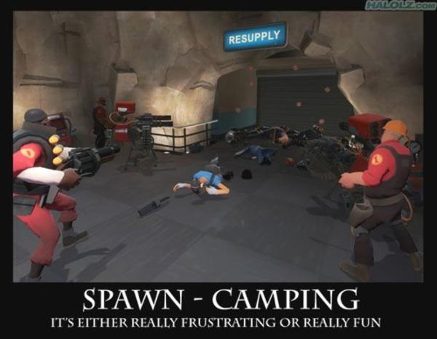
Mechanics - frame works / Theories
Lets use this formula on a game.
In a First-Person Shooter video game, a common mechanic is for players to have “spawn points” – dedicated places on the map where they re-appear after getting killed.
Spawn points are a mechanic.
This leads to the dynamic where a player may sit next to a spawn point and immediately kill anyone as soon as they respawn.
And lastly, the aesthetics would likely be frustration at the prospect of coming back into play only to be killed again immediately.

Slide 37
multiple aesthetics
There are eight type of Aesthetics as stated by Hunicke, LeBlanc and Zubek:
Sensation (Game as sense-pleasure): Player experiences something completely unfamiliar.
Fantasy (Game as make-believe): Imaginary world.
Narrative (Game as drama): A story that drives the player to keep coming back
Challenge (Game as obstacle course): Urge to master something. Boosts a game's replayability.
Fellowship (Game as social framework): A community where the player is an active part of it. Almost exclusive for multiplayer games.
Discovery (Game as uncharted territory): Urge to explore game world.
Expression (Game as self-discovery): Own creativity. For example, creating character resembling player's own avatar.
Submission (Game as pastime): Connection to the game, as a whole, despite of constraints.

Slide 38
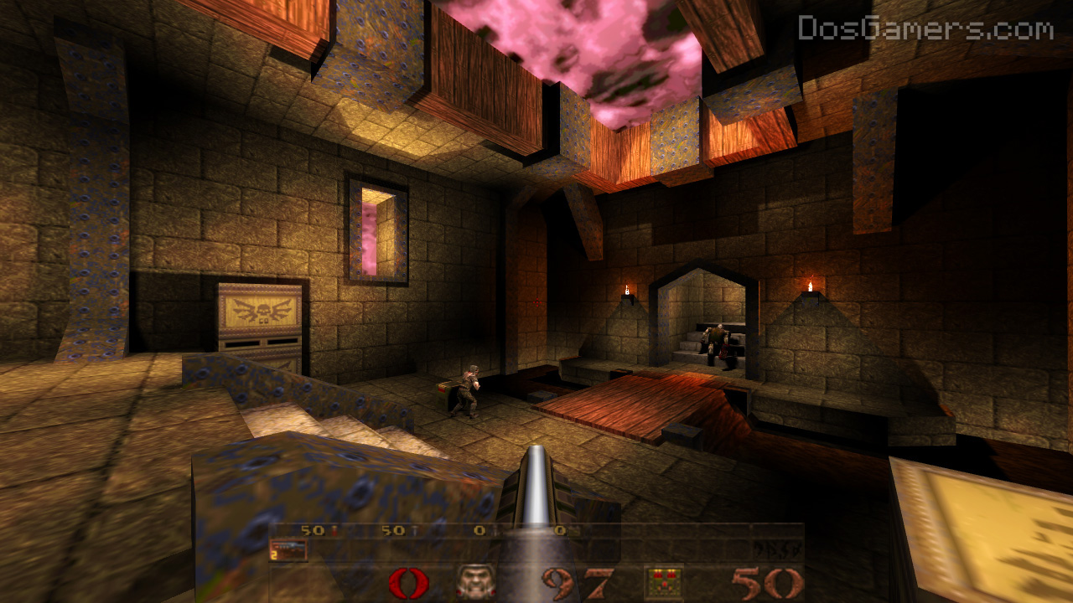
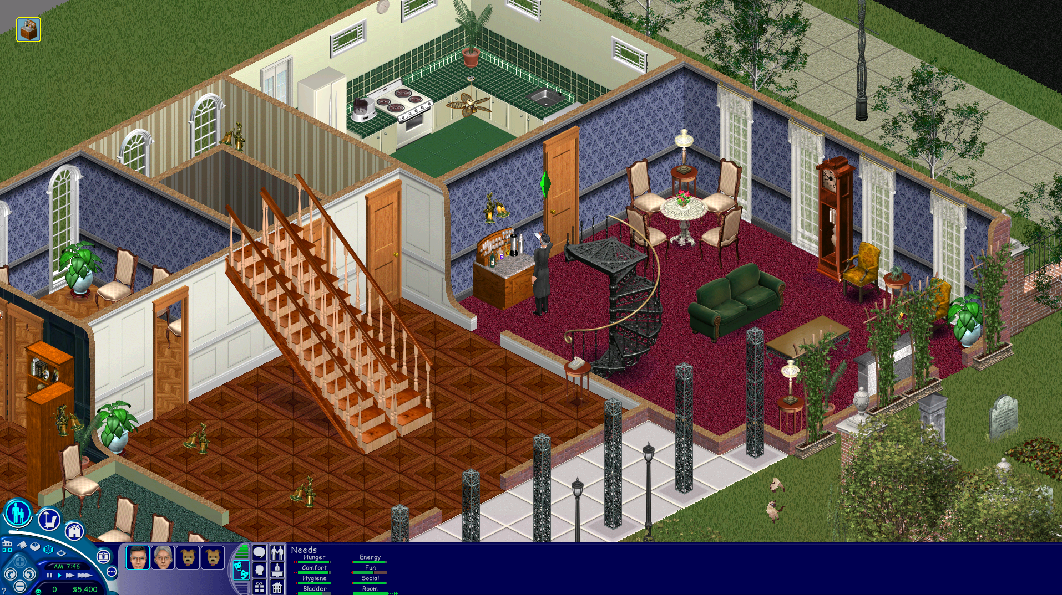
aesthetics
Sensation, Fantasy, Narrative, Challenge, Fellowship, Discovery, Expression, Submission
Quake: Challenge, Sensation, Competition, Fantasy.
The Sims: Discovery, Fantasy, Expression, Narrative.

Slide 39
Consistency and Fairness


Mechanics
Dynamics
Aesthetics
Designer
Player

Slide 40
To conclude
The MDA framework bridges the makers to the players. Makers can create a game starting at the M or the A. If one developer creates a unique gameplay mechanic, to see if they want to go through with it they can think about what sort of dynamic it would create when a player interacted with it. Based on this predicted dynamic, what sort of emotion would the player feel?
From the player's perspective, few people will ever get past the Aesthetics. Many will just say, “Oh, that game was fun,” and be done with it. Analytical gamers and reviewers will potentially take it all the way, however.
Critically analysing games using the MDA framework encourages us to design experience driven games
Notes:
The MDA framework bridges the makers to the players. Makers can create a game starting at the M or the A. If one developer creates a unique gameplay mechanic, to see if they want to go through with it they can think about what sort of dynamic it would create when a player interacted with it. Based on this predicted dynamic, what sort of emotion would the player feel? On the flip side, if a developer wants to give a certain emotion to the player, they can think of situations which may cause that emotion, and then a mechanic which could guide the player into a certain dynamic.
From the player's perspective, few people will ever get past the Aesthetics. Many will just say, “Oh, that game was fun,” and be done with it. Analytical gamers and reviewers will potentially take it all the way, however. They might realize what made the game they played fun, and then look at exactly why they are having fun. A reviewer doesn’t just say that a game was fun. They look into what it was that made a game fun, and then looked at the reason that ‘what’ happened. Many magazines such as GameInformer break games into sections such as ‘Graphics’, ‘Sound’, ‘Replay Value’, ‘Playability’, etc. All of these attributes you should now be able to break down into the MDA Framework and say, “This game was replayable because ____. This game’s controls were broken because _____.” Let me know if you have any questions or comments as always, I would love to hear what you think on this subject!

Slide 41
6-11 fRAMEWORK
This paper describes the “6-11 Framework”, a new game analysis and design methodology defined to help game designers in the process of crafting emotionally engaging and, ultimately, “fun”experiences.
The "6-11 Framework" (Dillon 2010) tries to address these issues by providing a new taxonomy for game aesthetics which should be easy to relate to actual game dynamics. This process should result in a clearer and easier to understand picture of why a game is “fun” and how players’ emotional experience develops throughout the game.
Notes:
https://www.academia.edu/1571687/THE_6-11_FRAMEWORK_A_NEW_METHODOLOGY_FOR_GAME_ANALYSIS_AND_DESIGN
http://gangles.ca/2009/08/21/mda/

Slide 42
6-11 fRAMEWORK
Six Emotions are:
Fear , Anger, Joy /happiness, Pride, Sadness, Excitement
Eleven core Instincts are:
Survival (Fight or Flight), Self Identification, Collecting, Greed, Protection / Care / Nurture, Aggressiveness, Revenge, Competition, Communication, Exploration / Curiosity, Colour Appreciation
The main idea behind the 6-11 Framework is that these emotions and instincts interact with each other to build a network or sequence that should end with “Joy” and/or “Excitement”, so as to provide players with a meaningful and fun experience.
Notes:
https://www.academia.edu/1571687/THE_6-11_FRAMEWORK_A_NEW_METHODOLOGY_FOR_GAME_ANALYSIS_AND_DESIGN
http://gangles.ca/2009/08/21/mda/

Slide 43
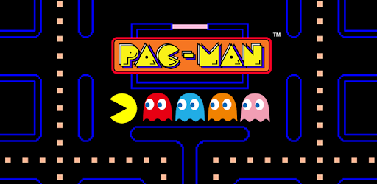
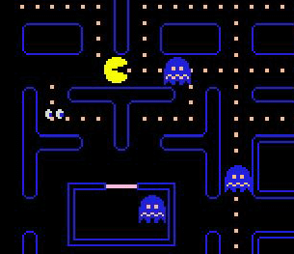
Lets look at a simple formula of paceman
Fear
Six Emotions are:
Fear , Anger, Joy /happiness, Pride, Sadness, Excitement.
Survival
Anger
Eleven core Instincts are:
Survival (Fight or Flight), Self Identification, Collecting, Greed, Protection / Care / Nurture, Aggressiveness, Revenge, Competition, Communication, Exploration / Curiosity, Colour Appreciation
Revenge
Excitement
Notes:
To gain a better understanding about the possible
interactions between emotions and instincts we can
describe by using this model, let us imagine we are
designing a hypothetic action/adventure first person
game where we start by immersing the player in a
beautiful and colorful environment.
The luscious environment will naturally resonate
with our “color appreciation” instinct, giving the
player a sense of well-being and an early feeling of
satisfaction/joy. This, together with the “self
identification” instinct we stimulated through a
proper first person perspective and, possibly, a
compelling background storyline, will also help in
triggering the player’s “curiosity” which, in turn, will
drive him to explore the surroundings. Once this
happens, a “fearful” emotional state can be easily
induced by a sudden encounter with a hostile
creature, triggering the “survival” instincts with
consequent “excitement” for the ensuing battle and
confrontation.
The whole gaming experience, and the corresponding
sequence of emotions and instincts, can be
represented through a diagram, shown in Figure 1,
where we see how specific emotions lead to instincts
that, in turn, push the player to act into the game by
means of the game dynamics, which are then made
possible through particular mechanics. For example,
here, our curiosity will make us explore the
environment, walking around and eventually solving
some environmental puzzle by opening/unlocking
hidden passages, and then, once the dangerous
encounter has been set, it will be our survival instinct
to naturally drive our actions, for example by fighting
the monster or by trying to escape to a safe area.
Either way, the resulting experience and adrenaline
rush will definitely bring excitement and, ultimately,
deliver a fun experience to our brave adventurer.

Slide 44
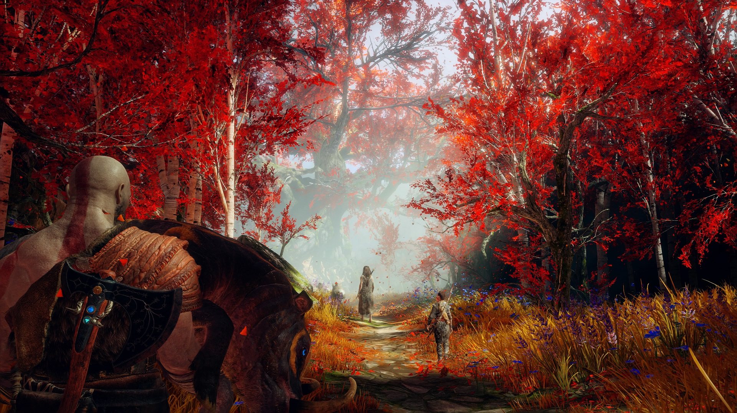
FPS in a beautiful and colourful environment.
Identification
Colour Appreciation
Curiosity
Joy
Dynamics
Exploring
Roaming
Fear
Survival
Six Emotions are:
Fear , Anger Joy /happiness, Pride, Sadness, Excitement.
Mechanics
Moving
Operating
Excitement
Dynamics
Fighting
Dynamics
Escaping
Eleven core Instincts are:
Survival (Fight or Flight), Self Identification, Collecting, Greed, Protection / Care / Nurture, Aggressiveness, Revenge, Competition, Communication, Exploration / Curiosity, Colour Appreciation
Mechanics
Aiming
Shooting
Striking
Blocking
Mechanics
Running
Hiding
Jumping
44
Notes:
To gain a better understanding about the possible
interactions between emotions and instincts we can
describe by using this model, let us imagine we are
designing a hypothetic action/adventure first person
game where we start by immersing the player in a
beautiful and colorful environment.
The luscious environment will naturally resonate
with our “color appreciation” instinct, giving the
player a sense of well-being and an early feeling of
satisfaction/joy. This, together with the “self
identification” instinct we stimulated through a
proper first person perspective and, possibly, a
compelling background storyline, will also help in
triggering the player’s “curiosity” which, in turn, will
drive him to explore the surroundings. Once this
happens, a “fearful” emotional state can be easily
induced by a sudden encounter with a hostile
creature, triggering the “survival” instincts with
consequent “excitement” for the ensuing battle and
confrontation.
The whole gaming experience, and the corresponding
sequence of emotions and instincts, can be
represented through a diagram, shown in Figure 1,
where we see how specific emotions lead to instincts
that, in turn, push the player to act into the game by
means of the game dynamics, which are then made
possible through particular mechanics. For example,
here, our curiosity will make us explore the
environment, walking around and eventually solving
some environmental puzzle by opening/unlocking
hidden passages, and then, once the dangerous
encounter has been set, it will be our survival instinct
to naturally drive our actions, for example by fighting
the monster or by trying to escape to a safe area.
Either way, the resulting experience and adrenaline
rush will definitely bring excitement and, ultimately,
deliver a fun experience to our brave adventurer.

Slide 45

Use these to help with your analysis
Both these design methodologies are both on Moodle.
Read and use these formats to breakdown the title you are analysing

Slide 46
Summary
Unpredictability in games
Games Mechanics
Types of Mechanics
Mechanics as Metaphor
Frame Work

Slide 47

Rules
There is one very important part of mechanics that I have only touched on this week.
Have I cover all aspects of mechanics……no I have but I given you the foundations. Build upon this and research further read the materials on Talis please.

Slide 48
Hey, what do we now
Think about using the formats introduced today to break down you analyses.
Should I be writing at this stage no, playing your selected title, note taking and reading to find resources.
You all should have selected a title at this point.

